Slide 1
Kotlin – Fun and Classes
BCS421 - Mobile Development
By Dr. Moaath Alrajab
Computing Division
School of Engineering Tech.

Slide 2
Kotlin Functions and Classes
The next big thing in the Java world

Slide 3
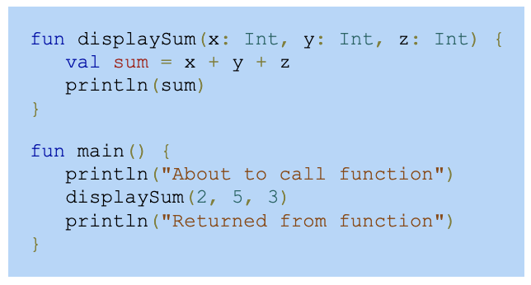
Kotlin Functions
A function is a named group of statements. A Kotlin function is declared with the fun keyword followed by the function name and parameter list in parentheses (). A parameter is a variable that supplies the function with input. The function's statements are enclosed in braces {} in the function body.

Slide 4
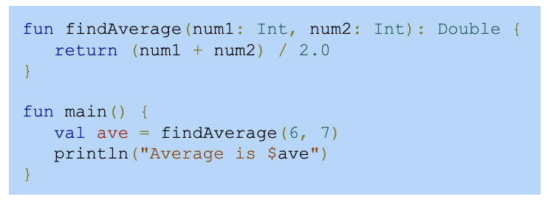
Returning a value
A function may return a single value with a return statement. The value returned must match the data type specified to the right of the function's parameter list.

Slide 5
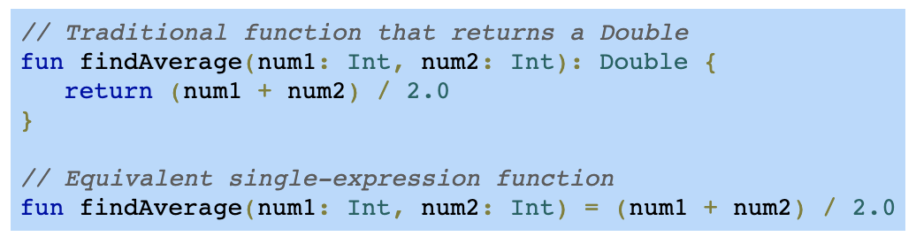
Single-expression functions
A single-expression function is a function that lists a single expression after the assignment operator (=). A single-expression function requires no return type, braces, or return statement.
https://kotlinlang.org/docs/functions.html

Slide 6
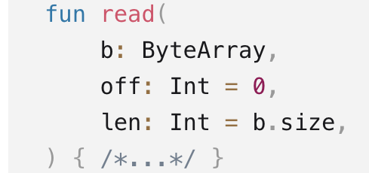
Function Default arguments
Function parameters can have default values, which are used when you skip the corresponding argument. This reduces the number of overloads:
If a default parameter precedes a parameter with no default value, the default value can only be used by calling the function with named arguments:
fun foo( bar: Int = 0, baz: Int, ) { /*...*/ }
foo(baz = 1) // The default value bar = 0 is used

Slide 7
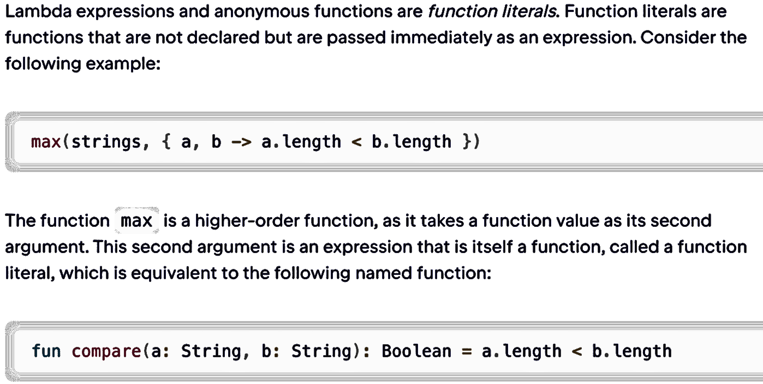
Lambda expressions

Slide 8
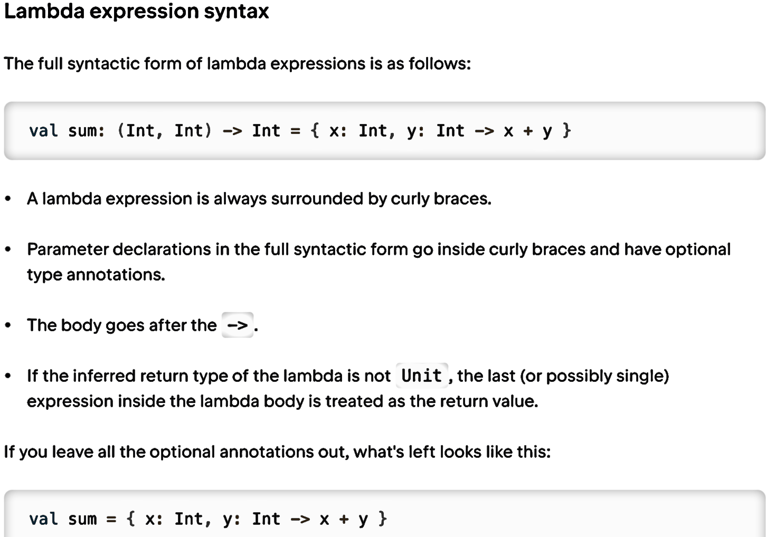
Lambda

Slide 9
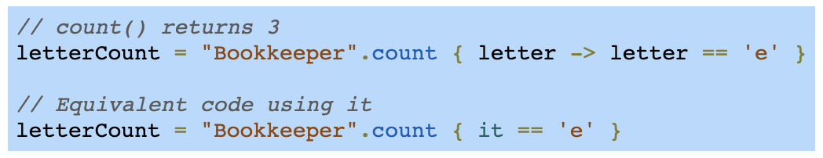
It parameter - function
If a lambda expression has only one parameter, the parameter and -> can be omitted, and it can be used to refer to the parameter instead. The figure below shows two equivalent calls to count(). The second call uses it to write a more concise lambda expression.

Slide 10
Classes and objects
A class is a programmer-defined data type that contains properties and methods.
A property is a variable defined inside a class.
A method is a function defined inside a class.
A Kotlin class is declared with the class keyword, followed by the class name and braces {} that surround the class's properties and methods.
An object is an instance of a class. A Kotlin object is created, or instantiated, by assigning a variable with a class name followed by parentheses. Ex: mustang = Auto() assigns mustang with an object instantiated from the Auto class.

Slide 11
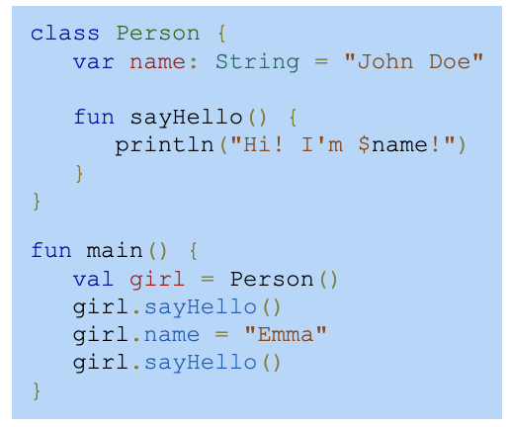
Class and object - example
Notes:
class Person { var name: String = "John Doe" fun sayHello() { println("Hi! I'm $name!") } }
girl
Person: name = "John Doe"
Hi! I'm Emma!
fun main() { val girl = Person() girl.sayHello() girl.name = "Emma" girl.sayHello() }

Slide 12
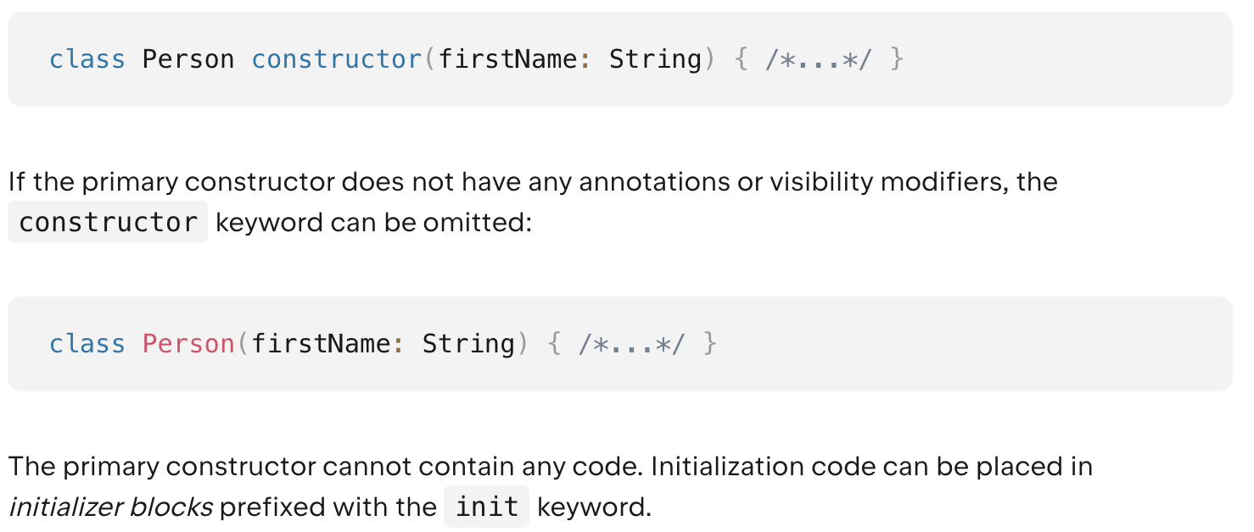
Constructors﻿
A class in Kotlin can have a primary constructor and one or more secondary constructors. The primary constructor is a part of the class header, and it goes after the class name and optional type parameters.

Slide 13
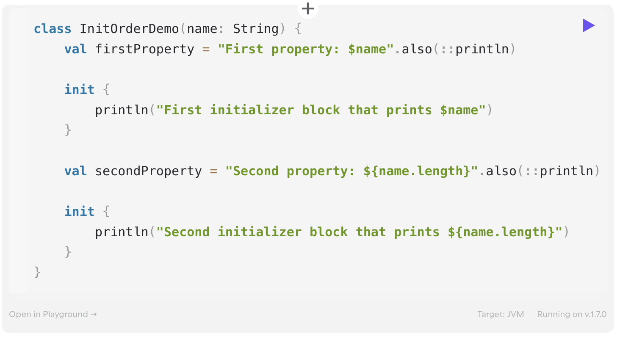
Constructors﻿ - example
Notes:
class InitOrderDemo(name: String) {
val firstProperty = "First property: $name".also(::println)
init {
println("First initializer block that prints $name")
}
val secondProperty = "Second property: ${name.length}".also(::println)
init {
println("Second initializer block that prints ${name.length}")
}
}

Slide 14
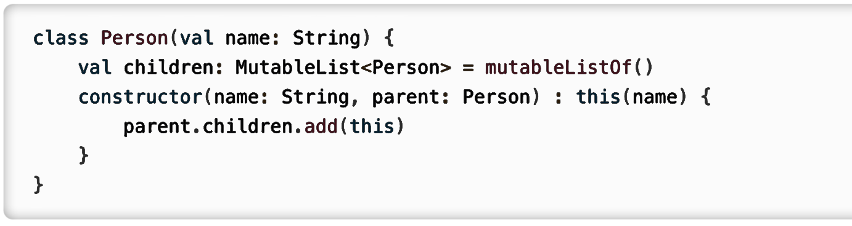
Secondary constructors﻿
If the class has a primary constructor, each secondary constructor needs to delegate to the primary constructor, either directly or indirectly through another secondary constructor(s). Delegation to another constructor of the same class is done using the this keyword:

Slide 15
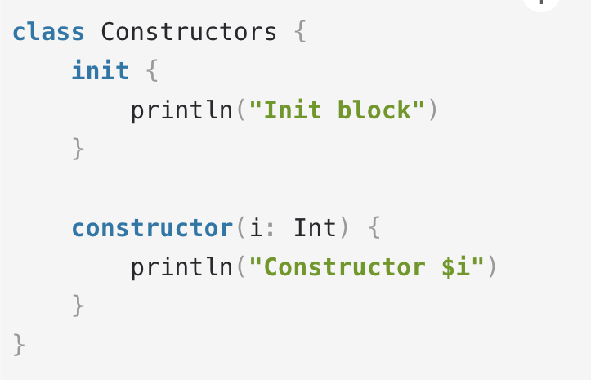
Secondary constructors﻿ cont.
Even if the class has no primary constructor, the delegation still happens implicitly, and the initializer blocks are still executed:

Slide 16
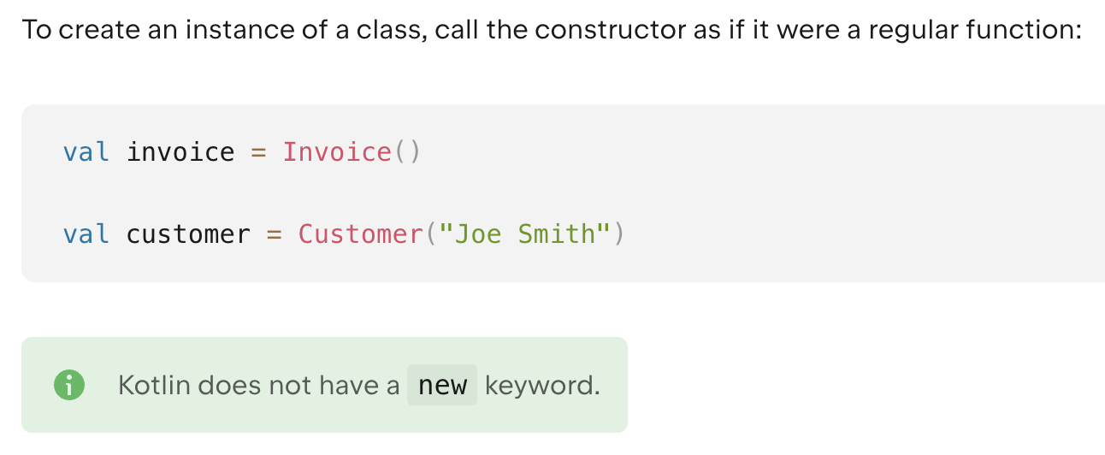
Creating instances of classes﻿

Slide 17
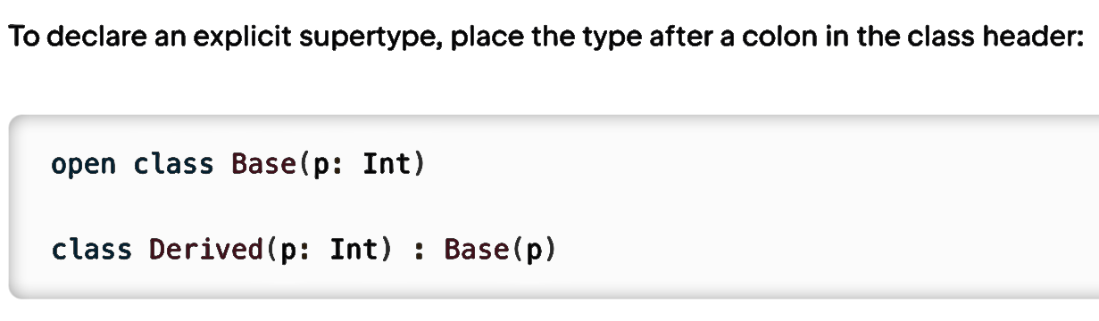
Class members﻿ and relationships
Class can contain constructors, init, functions, properties, nested and inner classes, and object declarations.
Inheritance﻿
Classes can be derived from each other and form inheritance hierarchies.
By default, Kotlin classes are final – they can’t be inherited. To make a class inheritable, mark it with the open keyword:

Slide 27
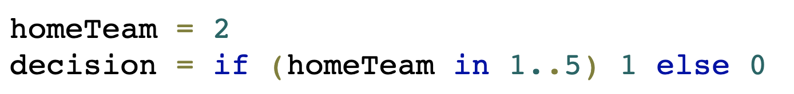
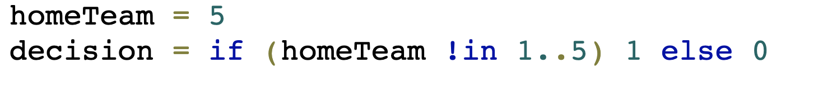
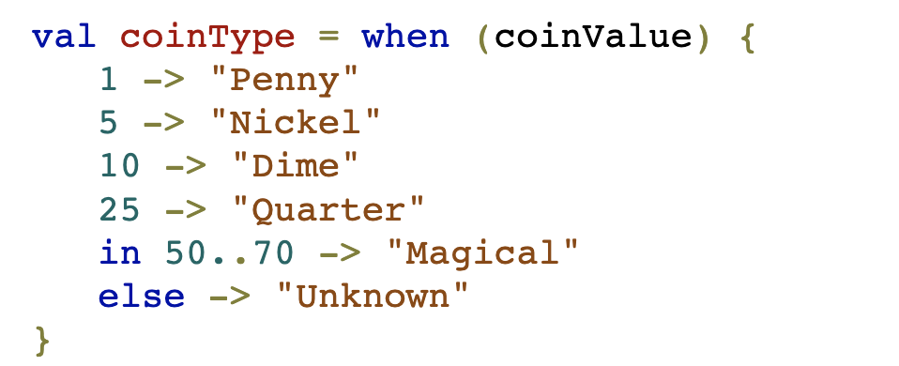
Conditions – in and when
Decision is 1
Decision is 0
When coinValue is 25 then
coinType is “Quarter”

Slide 28
Kotlin Hard vs Soft keywords
Hard keywords are always interpreted as language keywords and cannot be used as identifiers while soft keywords (including modifiers) can be used as identifiers (depends on the context).
Hard Keywords | Soft Keywords
as is used for type casts. specifies an alias for an import as? is used for safe type casts. break terminates the execution of a loop. fun declares a function. is checks that a value has a certain type. is used in when expressions for the same purpose. | by delegates the implementation of an interface to another object. delegates the implementation of the accessors for a property to another object. delegate is used as an annotation use-site target. get/set declares the getter and setter of a property. is used as an annotation use-site target. inline tells the compiler to inline a function and the lambdas passed to it at the call site.
https://kotlinlang.org/docs/keyword-reference.html#hard-keywords

Slide 29
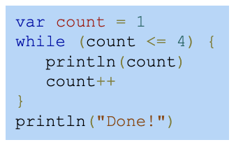
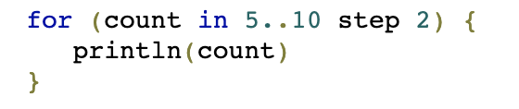
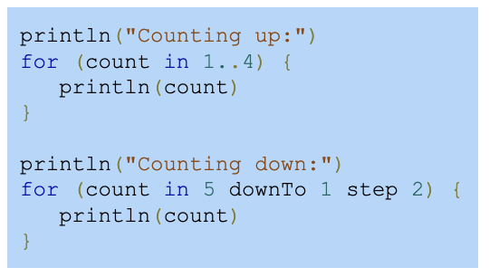
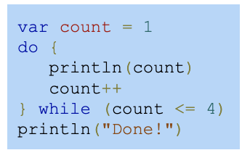
Loops
while loop
do-while loop
for loop

Slide 30
Conclusion
Kotlin is low-cost: can be developed in the same IDE, in the same project as Java code
Did I mention first-class Spring support?
It’s on track to become one of the leading JVM languages
It’s best suited to work with IntelliJ idea; it can be adapter to Eclipse, albeit with some shortcomings
It’s cool; allows bragging to friends about using the latest technologies

Slide 31
End of Intro To Kotlin
Thank you
Q/A

